Slide 1


Slide 2
PROGRAM TODAY
STUDENT MOBILITY FOR TRAINEESHIP (SMT)
ERASMUS+ ADDITIONAL FINANCIAL SUPPORT
PES PROGRAM
ATHENS PROGRAM
szakgyak@bme.hu

Slide 3

ERASMUS+
Student Mobility for Traineeships (SMT)
Traineeships to gain international experience
Host company/ laboratory – find individually
Ongoing application
Duration: min 2 months – max 12 months
Available on all study levels
Two types:
During studies – must have active student status
After graduation – within one year of the graduation
Call for applications: https://nki.bme.hu/SZAKGYAK
szakgyak@bme.hu

Slide 4
Erasmus+ Additional financial supports
Fewer opportunities: 250 EUR/months
Next deadline for applications: May, 2026
Only if you have applied for a mobility!
Students with disabilities or long-term illnesses
Amount: based on the opinion of the specialist and decided by Tempus Public Foundation
E-mail: erasmus.kieg@bme.hu
https://nki.bme.hu/node/6140

Slide 5
ERASMUS+ Program
Traineeship program: szakgyak@bme.hu
Staff mobility: szemelyzetimobilitas@bme.hu
Study Abroad erasmus@bme.hu
BIP bip@bme.hu
Webpage: http://nki.bme.hu/
https://nki.bme.hu/ERASMUS%20BIP%20for%20Students

Slide 6
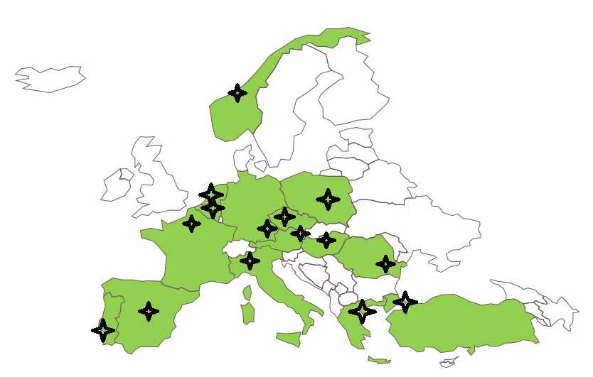


ATHENS
(Advanced Technologies in Higher Education Network/Socrates)
nki.bme.hu/BMEAthens
Next session: 14 – 21 March, 2026
Application deadline: 21 January.
15 partner institution
1 week intensive course, twice a year (March, November)
1 credit/course
The course is free of charge, travel and accomodation costs are financed by the students or BIP
nki.bme.hu

Slide 7

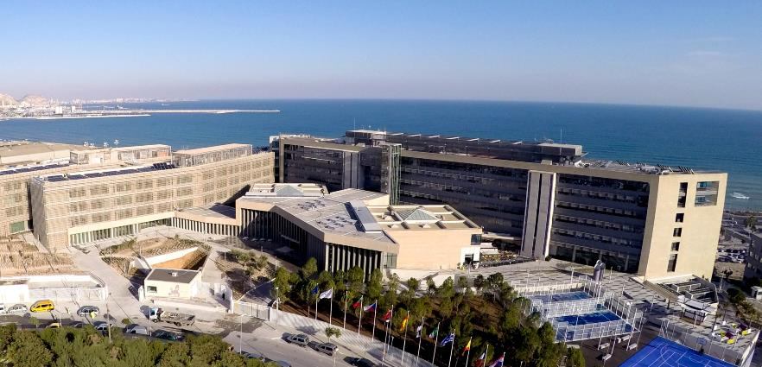
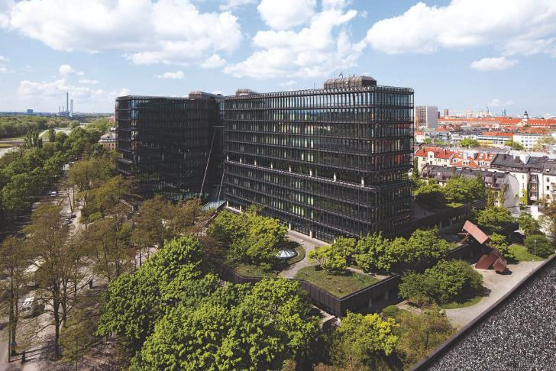
Pan-European Seal (PES) Program
Professional, paid traineeship program at EU bodies
Who can apply? Final year BSc, MSc, or graduated MSc students, PhD students
Location of the traineeship
EUIPO: Alicante The Hague EPO: München
NKI
internationalrelations@bme.hu

Slide 8
PES Program
BME Application procedure:
1. BME application until 16.02. 2026
MOTIVATION LETTER IS THE MOST IMPORTANT!
2. selected students are nominated to the bodies
3. Students apply individually
Further info: https://nki.bme.hu/node/6014

Slide 9
Thank you for your attention!

