Slide 1
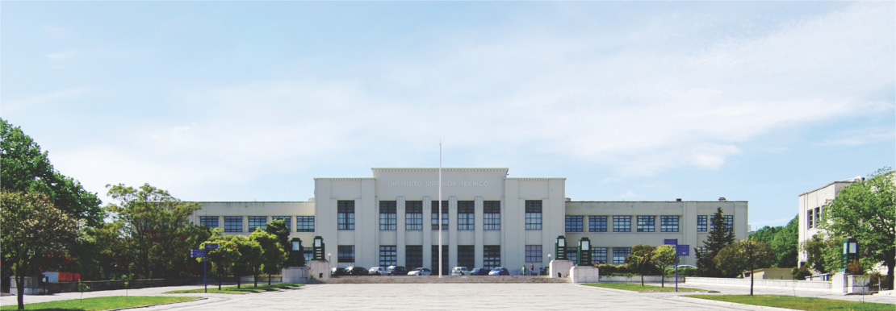
Guilherme Amaral
Instituto Superior Técnico | Portugal

Slide 2
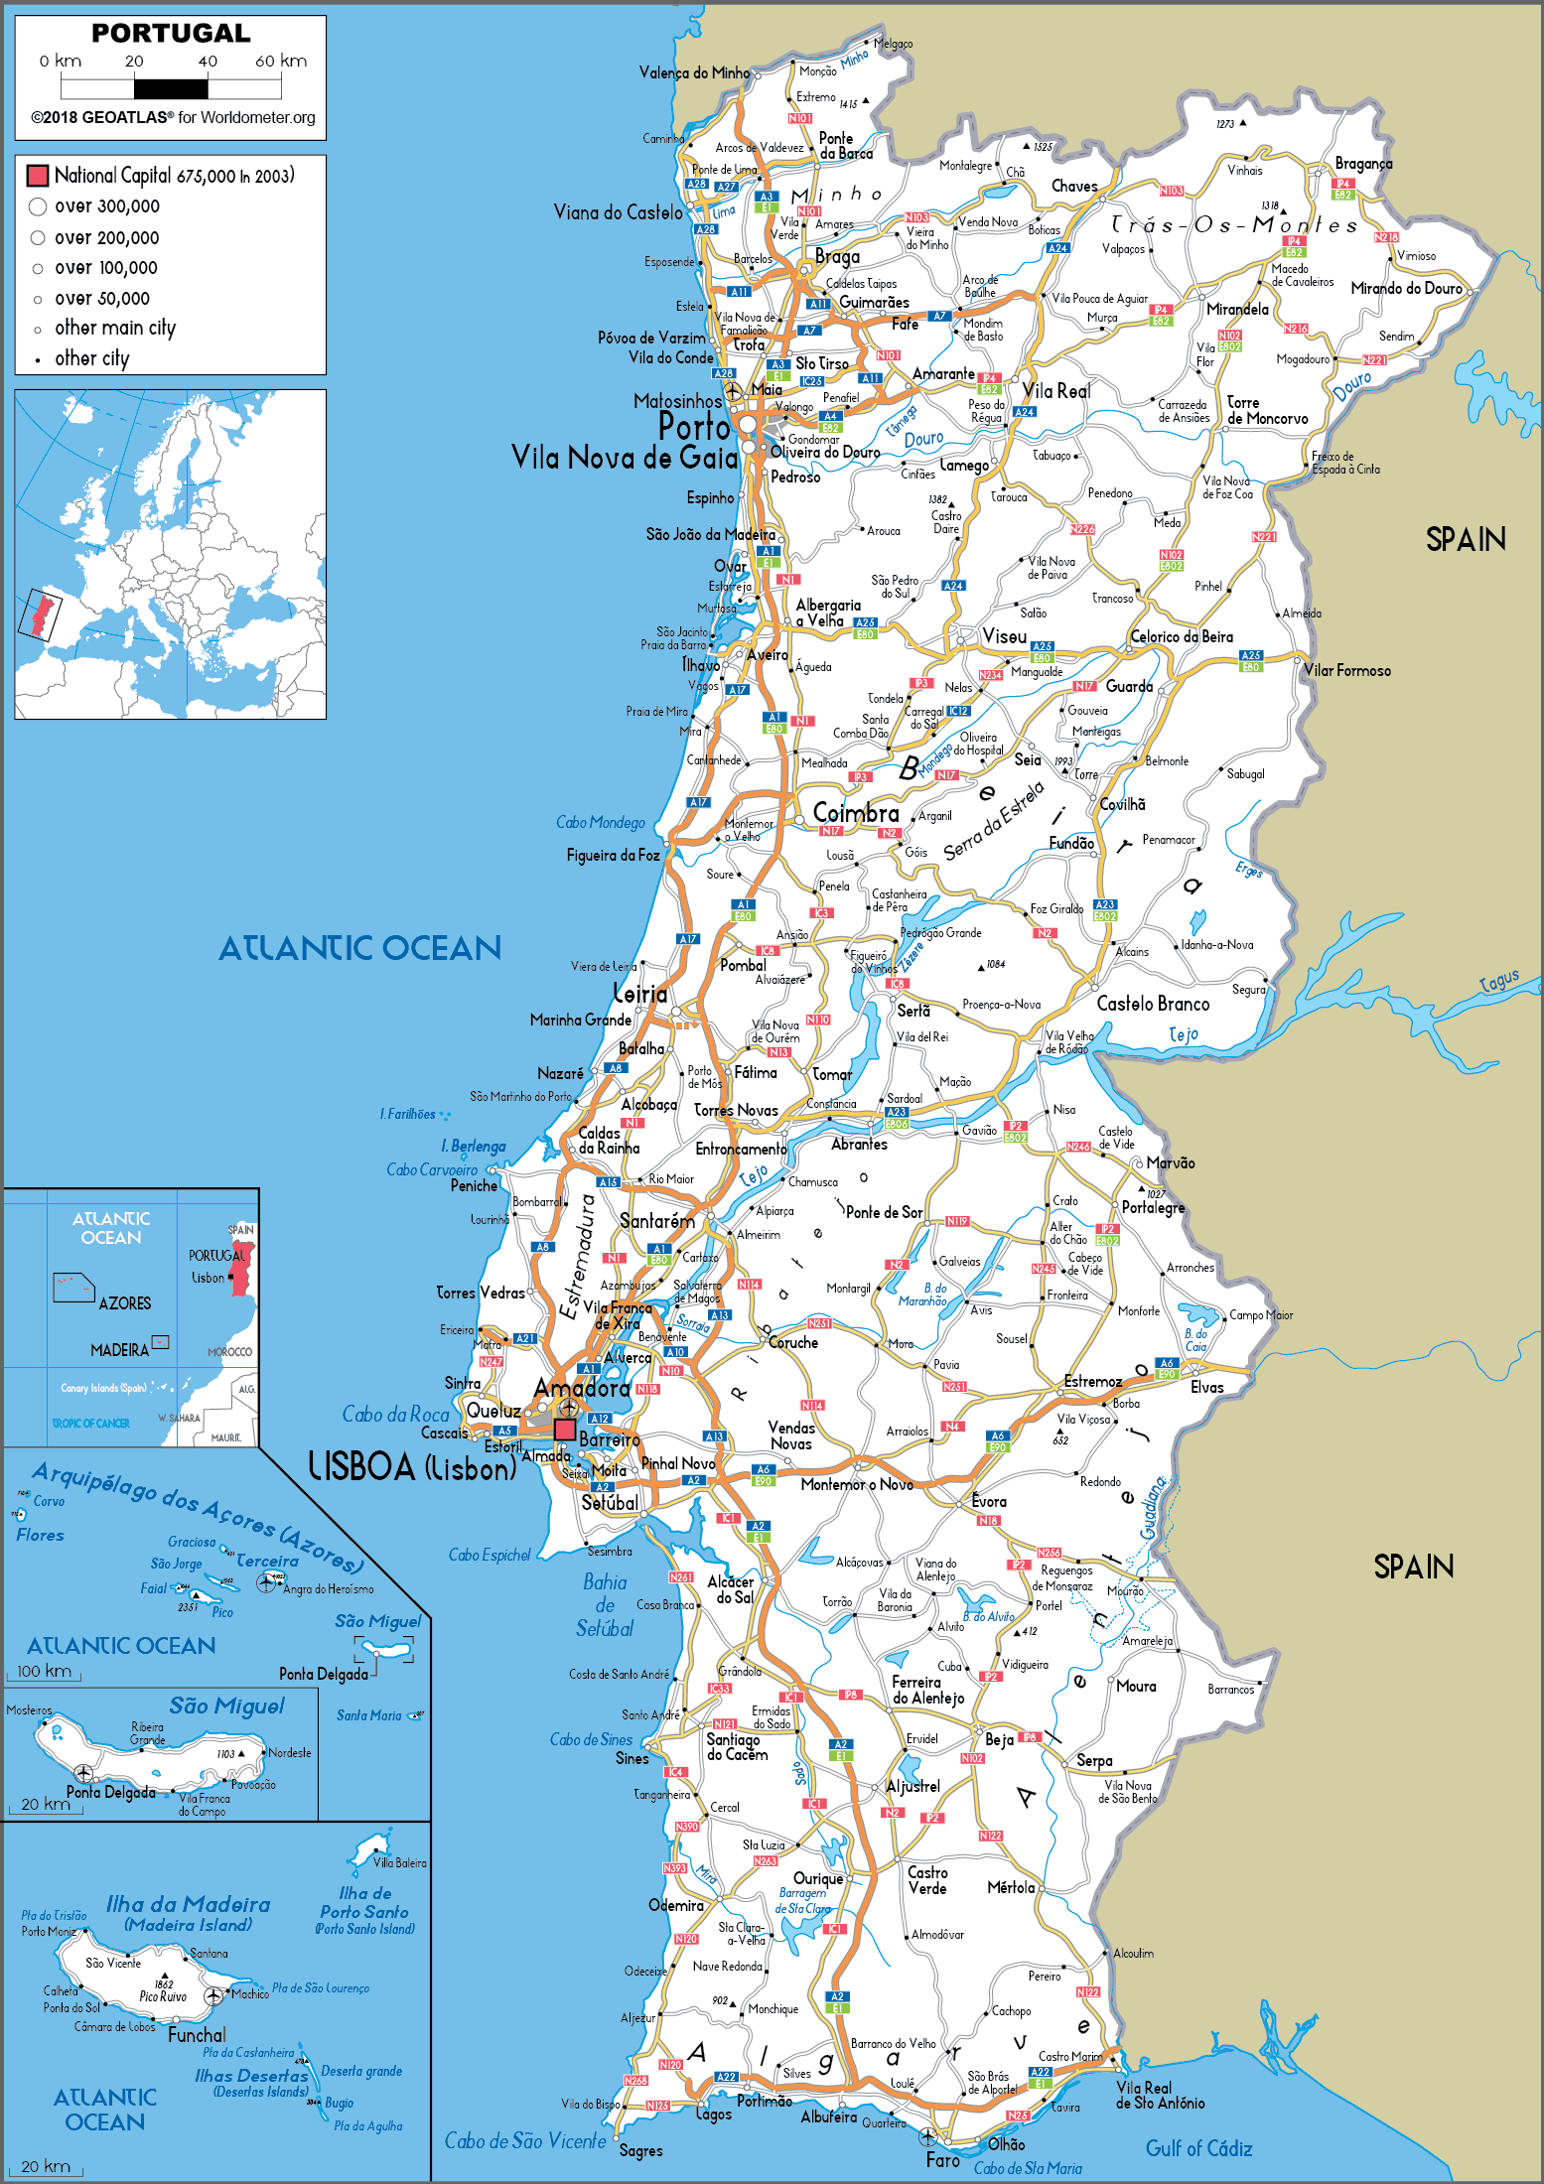
Portugal
Weather
Life outside the University
Transportation
Accomodation

Slide 3
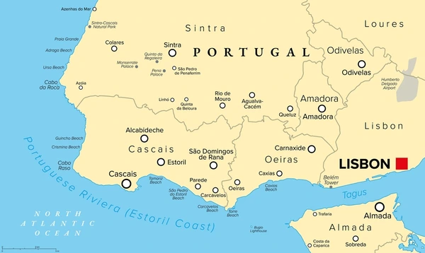
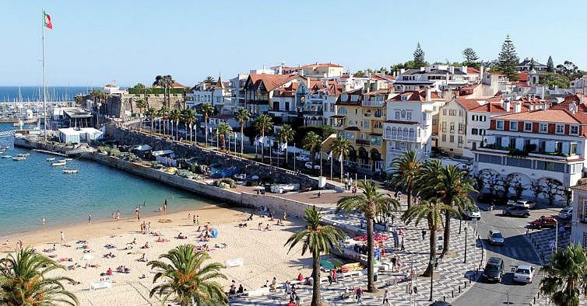
Portugal

Slide 4
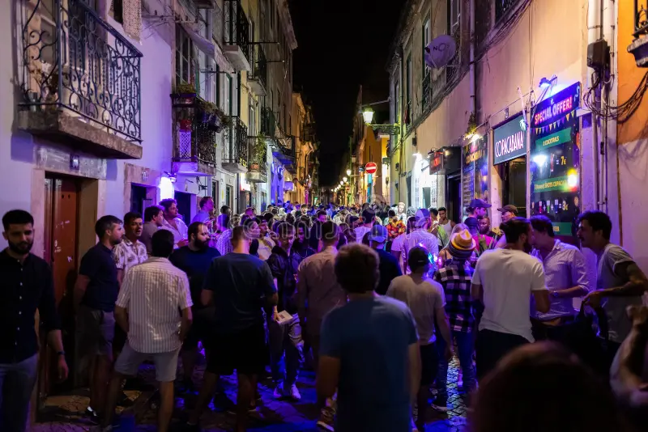
Portugal
Very active nightlife
Super diverse culinary types
Cultural rich city

Slide 5
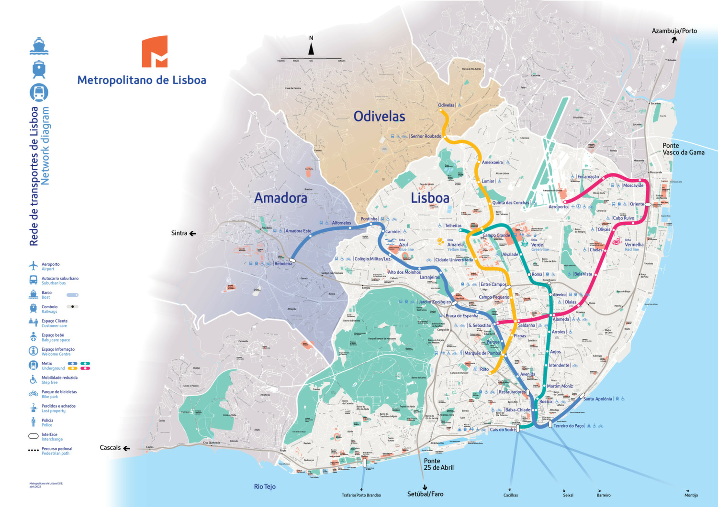
Portugal
Simple Metro grid
Two train lines

Slide 6
Portugal
Relatively high rents increasing toward the center of Lisbon
North and South of Portugal have lower rents then the capital
Options:
- Students Residence
- Shared Houses (Private Renting)

Slide 7
Instituto Superior Técnico - IST
Highest Ranked Engeneering Unversity (Portugal)
Campus on city center (Saldanha)
11 000 Students
Two semestres, divided in two quarters

Slide 8
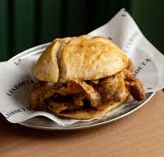
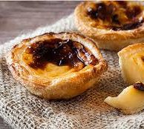
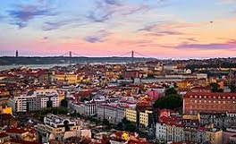
QUESTIONS?

