Slide 1
Title slide + image
Welcome!
MSc TIL | Bryan Inggas

Slide 2
Contents
About TU Delft
Finding Accommodation
How to Get Around in Delft
Student Life at TU Delft
What’s Best About TU Delft
Useful Tips for New Students
Final Thoughts
Q&A

Slide 3
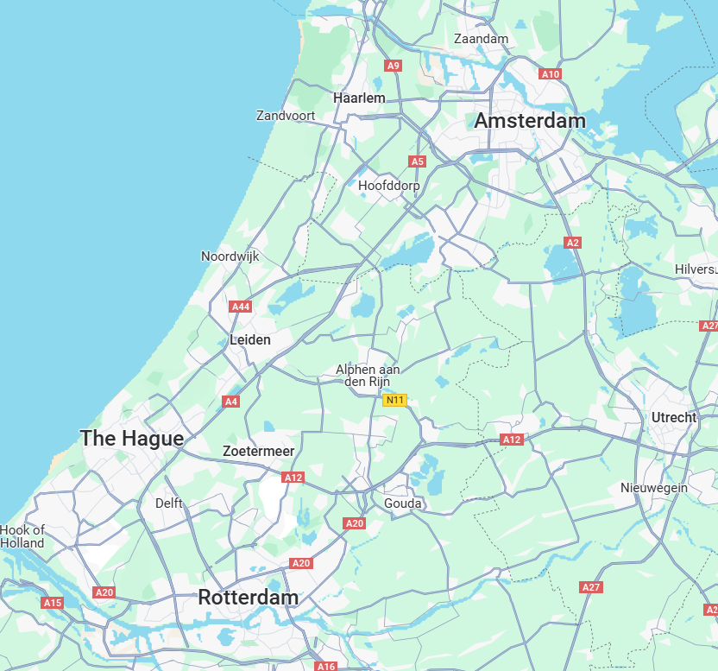
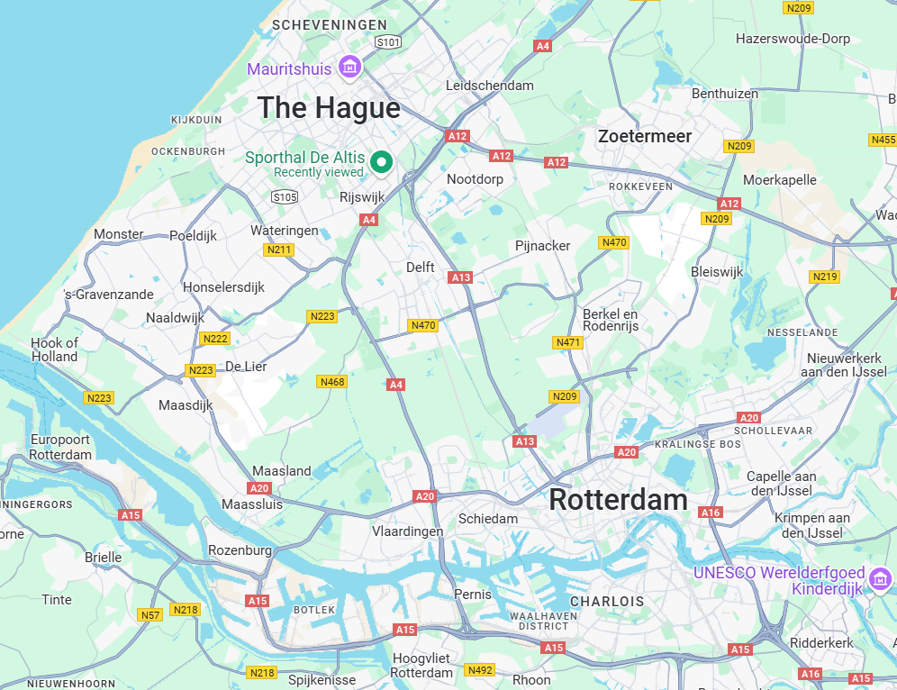
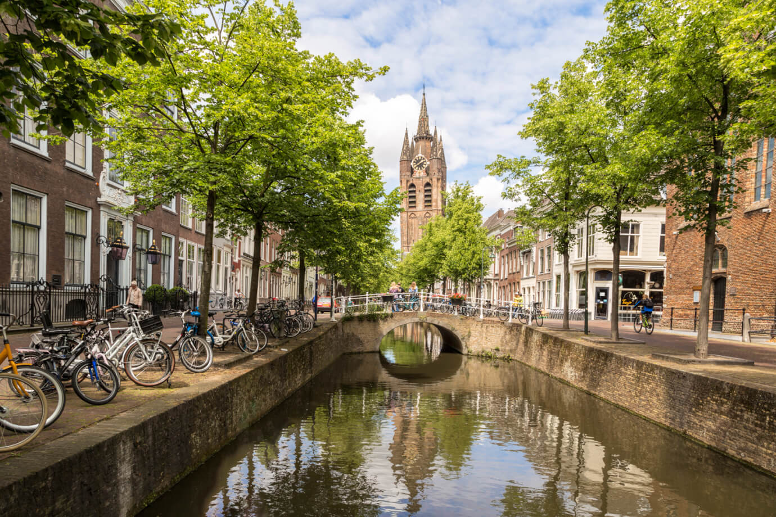
Technische Universiteit Delft (TU Delft)
Location:
Delft (city)
Here is Delft!
Small and historic city, lots of canals

Slide 4
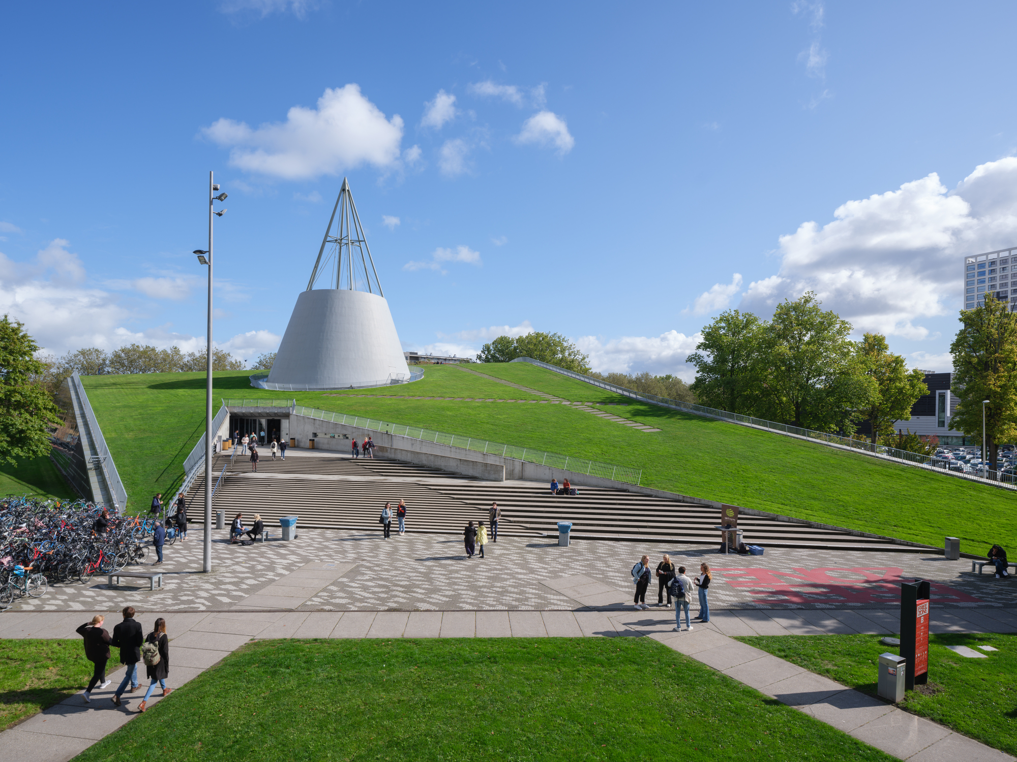
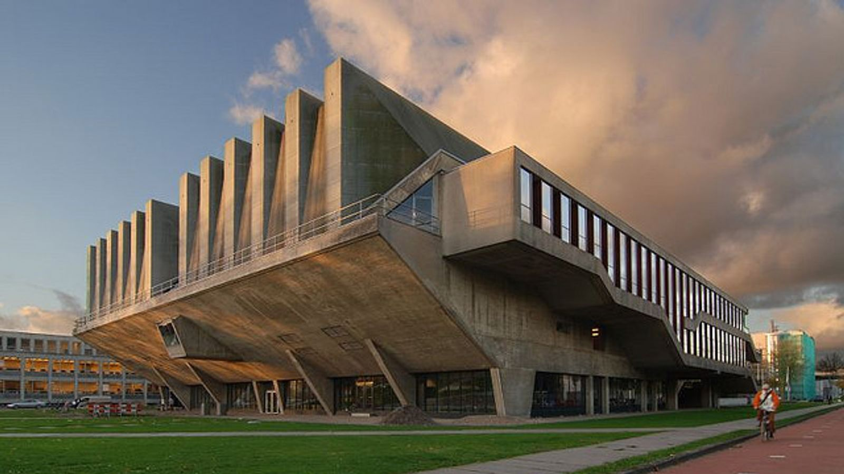
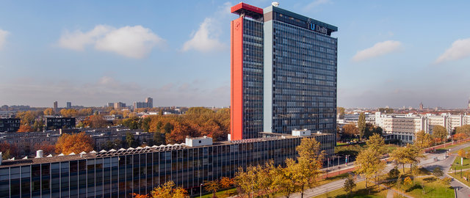
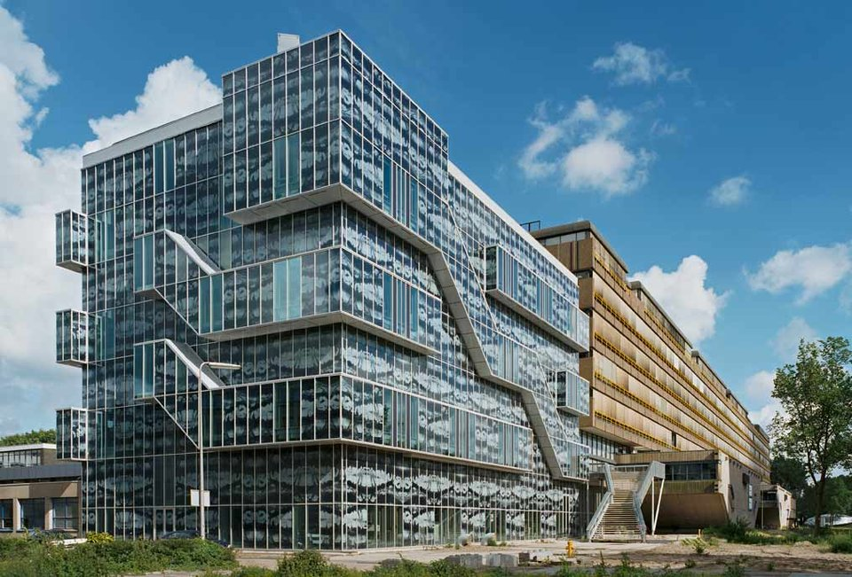
TU Delft
Rank 49 (QS World University Rankings)
Around 26,000 students
Usually work with quarters (10 weeks per quarter, 8 weeks of lectures and 2 weeks of exams period)
Nice and Large Buildings ☺

Slide 5
Finding Accommodation
TU Delft does not guarantee housing, so start early!
Options:
Delft University Housing (via TU Delft)
Student Residences: DUWO (most popular, €35 registration fee)
Private Market: Kamernet, HousingAnywhere, Facebook groups
Shared Apartments
Tips:
Apply as soon as possible
Beware of scams – never pay upfront without visiting
Consider nearby cities like The Hague or Rotterdam

Slide 6
Useful Links for Accomodation:
https://www.tudelft.nl/onderwijs/studievoorlichting/praktische-zaken/huisvesting-op-kamers
https://www.tudelft.nl/en/education/study-programme-orientation/practical-matters/housing
https://www.room.nl/en/ (DUWO)
Facebook Groups
Find room / roommate in Delft
Delft Housing, Rooms, Apartments
Kamer in Delft
Housing Delft - Apartments & Housing in Delft
Etc.

Slide 7
How to Get Around in Delft
Bicycle: Most common mode of transport, available second-hand or for rent
Public Transport:
OV-chipkaart for trams, trains, and buses
Trains to Rotterdam, The Hague, Amsterdam are frequent
Discounts: Available for some transport services
Walking: Delft is a small and walkable city

Slide 8
Student Life at TU Delft
Academic Life:
Highly ranked university for engineering and technology
Innovative learning environment
Sports & Recreation:
X TU Delft: A sports and cultural center with facilities for fitness, dance, music, and team sports
Social Life:
Join student associations (sports, cultural, study-related)
Events and parties organized by student clubs (e.g. ESN Delft)
For night life: better to go to The Hague or Rotterdam ☺

Slide 9
What’s Best About TU Delft?
International Community: Diverse student body, student teams (e.g. Hyperloop team)
Innovation & Research: Cutting-edge technology and engineering projects
Campus Facilities: Modern libraries, labs, and maker spaces
City of Delft: A beautiful, historic city with a great student atmosphere
Good for your CV! ☺

Slide 10
Useful Tips for New Students
Registered at municipality
Get your BSN Number
Open a Dutch bank account
Register with a local GP and check for student insurance
Dutch Weather: Be prepared for rain, always carry a raincoat
Try Dutch food: Stroopwafels, Bitterballen, and Haring
TU Delft Introduction Programme (IP): special for international or exchange students

Slide 11
Final Thoughts
Stay curious
Be open to new experiences (willing to try new things)
Explore the country
Make the most out of your time ☺

Slide 12
Quote
Questions?
Email: bdsoinggas@tudelft.nl

Slide 13
Afsluiter
Thank you for your attention!
See you in Delft ☺
TU Delft Introduction | Bryan Inggas

