Slide 1
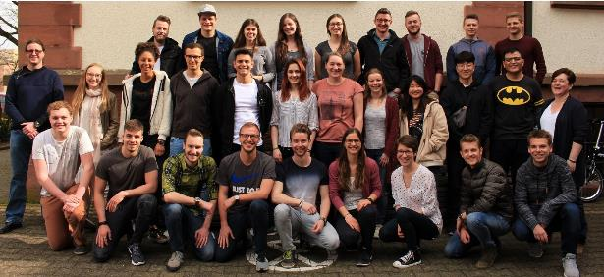
International Program in Engineering (IPE)

Slide 2

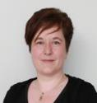
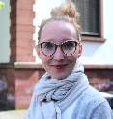

Introductions – The IPE Team
Prof. Dr. Andreas Schramm //
Jenni Loudon //
Verena Bauer //
Head of IPE
Responsibilities:
Program content, courses & credits
Lecturers
Administration
Responsibilities:
Administration & organisation of IPE
Administration
Responsibilities:
Housing
Excursions
Budget

Slide 3
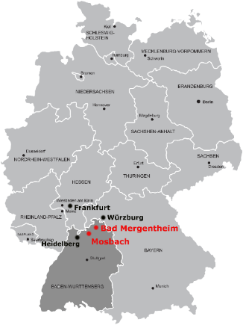

DHBW Mosbach - Key Facts
  Founded in 1980
  Two campuses: Mosbach and Bad Mergentheim
  More than 20 undergraduate study degrees in two faculties
  Currently 3,600 students
Campus Mosbach
Campus Bad Mergentheim
Notes:
3

Slide 4
IPE – Calendar 2022
(detailed schedule for 2022 t.b.c.)
Track length: | 12 weeks + 1 week student research project
Start of the semester: International students: | 4th April 2022
End of the semester: International students: | 3rd July 2022
Semester dates in detail: Engineering courses (Modules A-D) Student research project | 4th April – 26th June 2022 27th June – 3rd July 2022

Slide 5

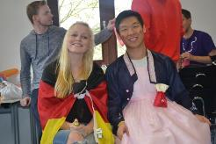
International Program basics
Ready-made set of courses worth 30 ECTS
Small class size: know all your class and faculty by name
Events and excursions organized for you
Housing arranged by the International Office
German buddy to answer your questions and help you settle in
Study together with international and German students
Enhance your personality and soft skills
Full support from the IP team before, during and after the semester

Slide 6
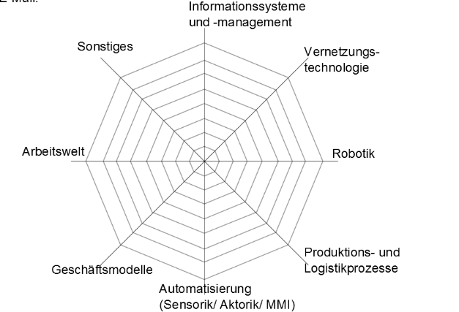
IPE – Overview
  Specialization „ Production Systems Engineering“
  Specific integrating & interdisciplinary modules (‚Broad‘ instead of ‚Deep‘)
  Seminaristic approach, Team-oriented scientific work
Engineering Operations
& Business Management
Automation Systems
Engineering
Production– and
Information Management
Student Research Project
(Studienarbeit)
Embedded Systems
(Internet of Things &
Technical Info Management)
Additional intercultural lectures
Social programs,
Excursions & Trips
Intensive German Classes
5

Slide 7
IPE – Modules in Detail
Modules | ECTS per module | Teaching and learning contents
A.) Automation Systems Engineering | 5 | A1.) Extended concepts in automation A2.) “Integrated Industry”: Seminar and Excursion A3.) Simulative engineering
B.) Engineering Operations & Business Management | 5 | B1.) Management of Industrial Processes B2.) Project Management B3.) International Business
C.) Production and Information Management | 5 | C1.) Business information systems in production and logistics C2.) Advanced concepts in production management C3.) Interdisciplinary seminar & lab practice
D.) Embedded Systems | 5 | D1.) Embedded Systems/IoT – Basics D2.) Technical Information Management D3.) Lab practice: embedded systems seminar
E.) Student Research Project | 5 | Individual student research project
F.) Social and Non-Technical Skills | 5 | F1.) Intensive language course F2.) Additional intercultural lectures F3.) Social programs, excursions & trips
ECTS in total: International Students | 30

Slide 8
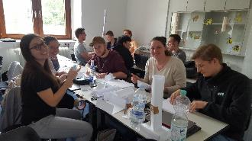
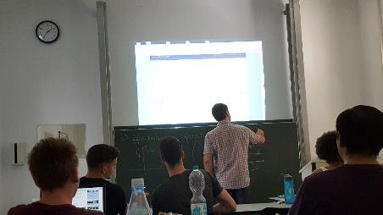
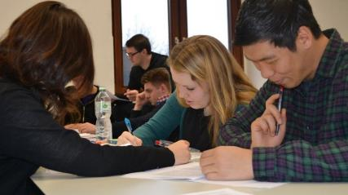
Study in English
All lectures and exams in English
International and multi-disciplinary faculty from USA, Russia, Hungary and, of course, Germany…
Notes:
German language course: block and weekly formats (Internationals)

Slide 9
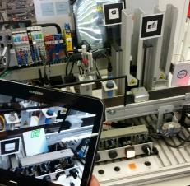
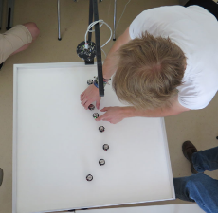
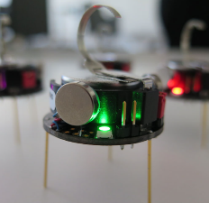
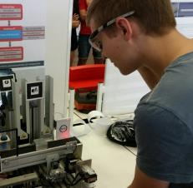
Lab Practice
Lab Industry 4.0
Experience end-to-end scenarios - from customer order through production and automation to product cost control.
"Living Lab“: continually updated with the latest technology to create the "production of the future".
Models and simulations to replicate typical production processes and facilities.
Real information systems, such as MES and ERP, to network, analyse and manage production. Process data management uses systems such as SCADA, OPC, Big data storage and Mining & Analyse.
Other labs for IPE
e-mobility Lab
high performance computing Lab
MOSbot Lab - Internet of Things

Slide 10
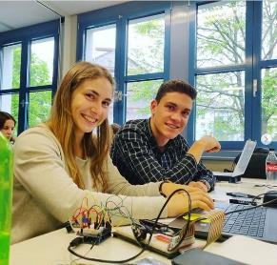
Student Research Project
Research and apply your new-found knowledge to an
engineering problem.
Your mentor will agree your research topic and provide
guidance as required.
Examples of student research topics :
urban farming controls
an automatic drink cooler
augmented reality app for maintenance visualization
swarm intelligence projects
robotics in production and logistics
QR-Paper
The final week of the semester is reserved for the Student Research Project to allow you time to intensively work on your research and you will present your project and written research on the final day.

Slide 11
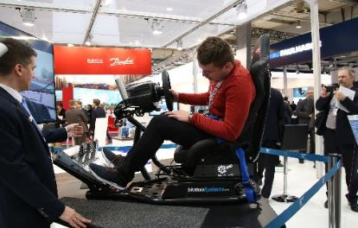
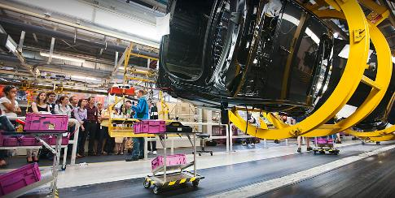
Company visits and excursions
Excursion to Hannover Messe
Company visits, e.g.
    Car manufacturers (BMW, Porsche,
    Audi, Mercedes)
    Brewery or Sektkellerei
    Industrial manufacturers (e.g. Kärcher, Stahlwerk etc.)
Team-building events, e.g.
    Wine tour Gundelsheim
    Climbing
    Lasergame, …
Excursion fee only 100€
Notes:
Mingle: Do not stay in your country groups, or Germans, etc.

Slide 12
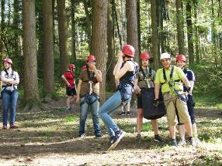

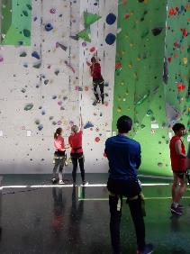
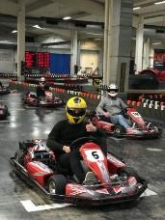
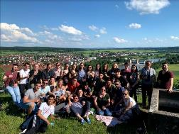
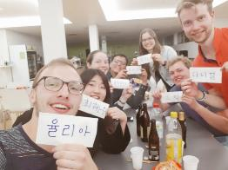
Teambuilding Events
Grow together as a group
    approx. 15 Internationals + 15 DHBW students
    (Mechatronics, Electrical Engineering,
    Computer Engineering, Industrial Engineering, Civil Engineering, Mechanical Engineering)
Establish lasting friendships with connections all around the globe
(participants from Mexico, Korea, Columbia, Turkey & EU countries)
Students regularly vote IPE their “best semester ever”!

Slide 13
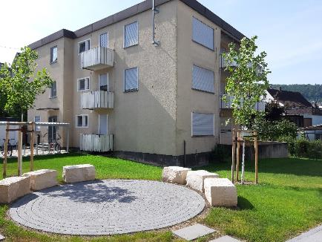
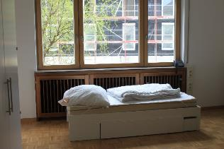
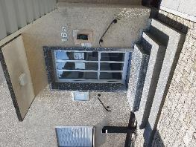
Accommodation
International students live together in our International House
Fully equipped kitchen, bathrooms & shared facilities
Walking distance of campus, town center, shops, restaurants and station
Monthly rent:
215-300€
including all bills

Slide 14



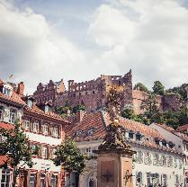
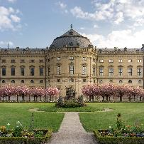
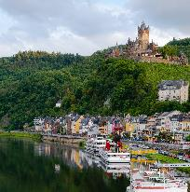
In the area and beyond...
There's so much to do within a short distance of Mosbach that you'll never be bored.
Get a rail or Flixbus card to get discount fares and, with budget airlines flying from Stuttgart airport, you can easily travel throughout Germany and Europe on weekends.
Würzburg with imposing residence
Heidelberg castle and old town
Explore Neckar valley & castles

Slide 15


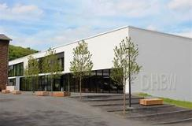
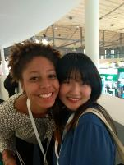
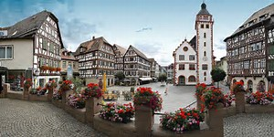
What are the benefits for you?
Prepare yourself for important global engineering topics
Work with and learn from student engineers from other disciplines
Become fluent in English
Build long-lasting friendships and connections all around the globe
Predetermined courses, arranged accommodation & full support
from our dedicated team on a small, friendly campus
Unique mix of study modules and excursions

Slide 16
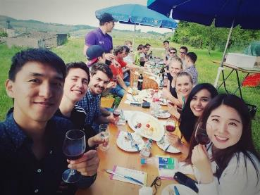
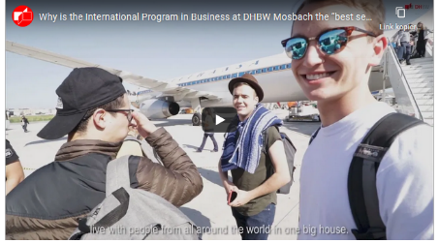
Application Process
  Nomination by 01 December
  Online Application by 15 December
  Admission Letter from DHBW with further information on the program
More information
For more information on our International Programs, check out the website.
  For general information for exchange students, go to www.mosbach.dhbw.de/exchange-students
  Watch our IPB video on YouTube made by one of our former exchange students!

Slide 17
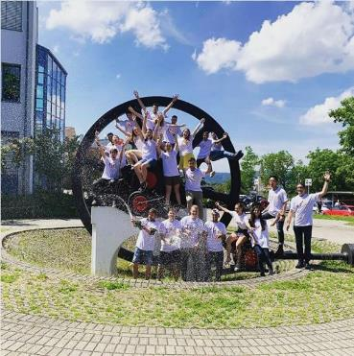
WE LOOK FORWARD TO RECEIVING YOUR APPLICATION
Any questions?
You can also email us at IP-Mosbach@mosbach.dhbw.de

